Slide 1
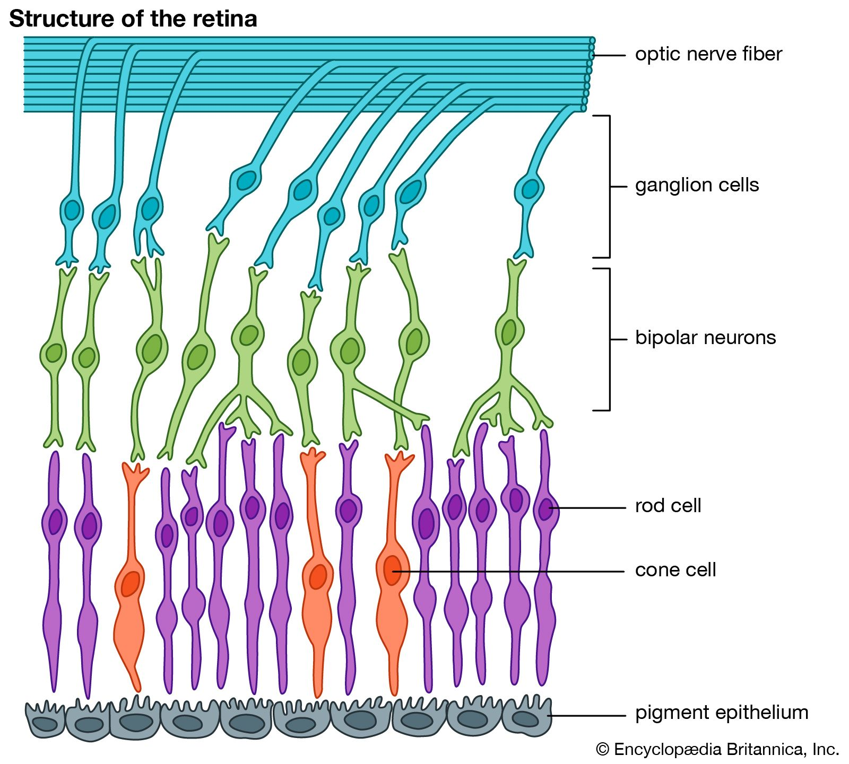

Slide 3
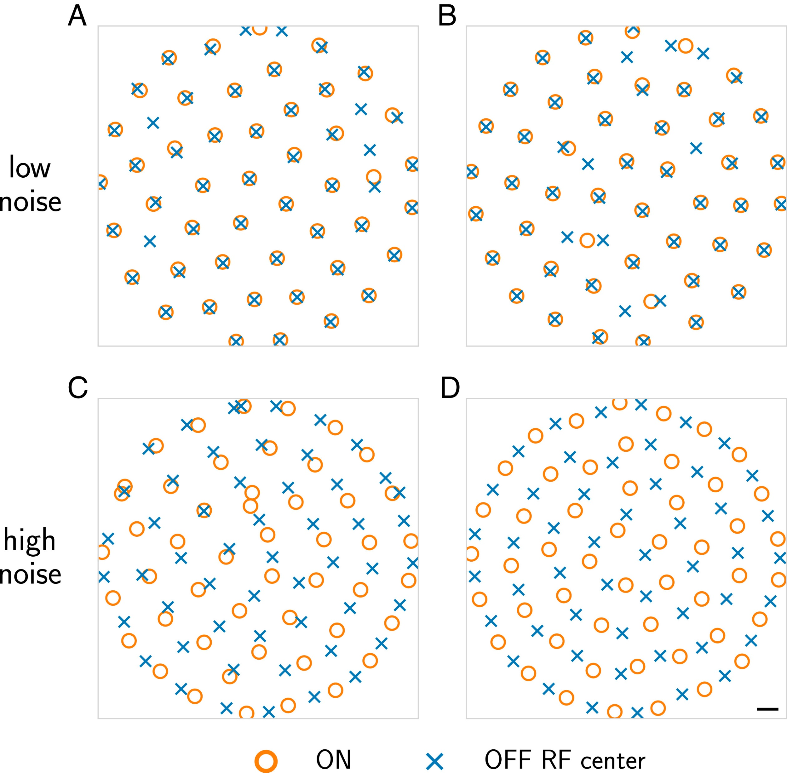

Slide 4

Aim 1: Understand how Retinal ganglion cells process colors
Notes:
Be more clear about why parasol cells are black and white

Slide 5
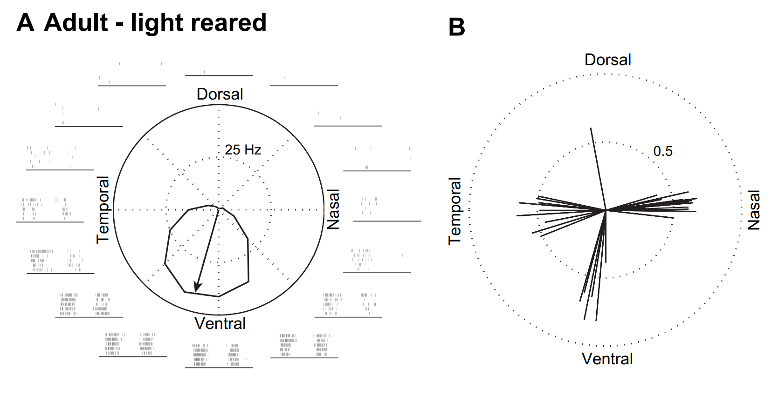
Aim 2: Understand how retinal ganglion cells process motion
Elstrott et al. (2008)

Slide 6
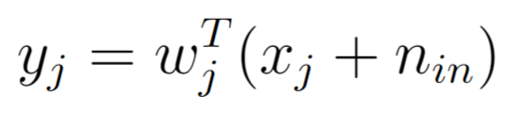
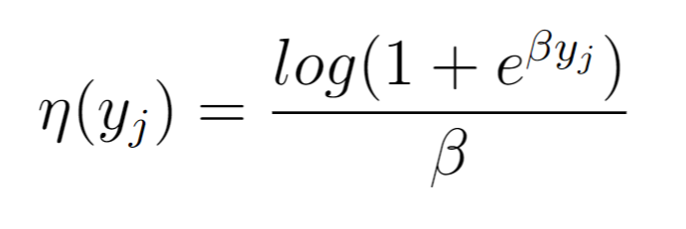
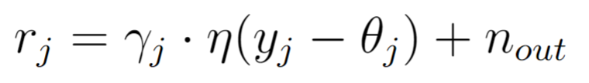
Forward model in 3 easy steps
1- Linear weighted inputs
2- Softplus output nonlinearity
3- Gain and threshold

Slide 7
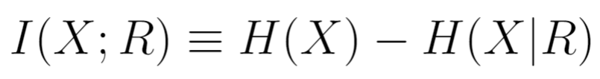
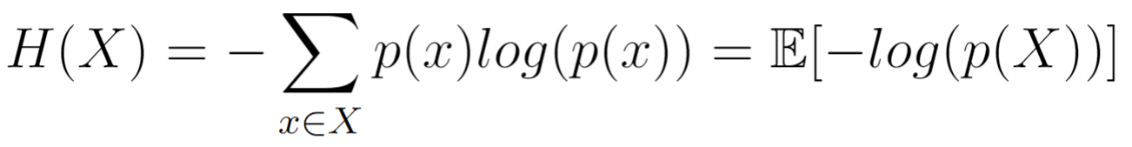
Maximizing mutual information

